Slide 1
Module-IV

Slide 2
Chapter Outline (1)
0. Introduction to Query Processing
1. Translating SQL Queries into Relational Algebra
2. Algorithms for SELECT and JOIN Operations
4. Algorithms for PROJECT and SET Operations
5. Implementing Aggregate Operations and Outer Joins
6. Using Heuristics in Query Optimization

Slide 3
0. Introduction to Query Processing (1)
Query optimization: the process of choosing a suitable execution strategy for processing a query.
Two internal representations of a query
Query Tree
Query Graph

Slide 4
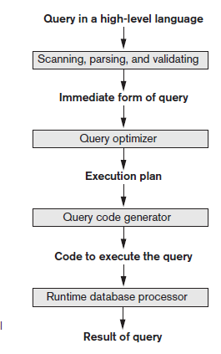
Introduction to Query Processing (2)
Steps in Query Processing

Slide 5
The scanner identifies the query tokens—such as SQL keywords,attribute names, and relation names—that appear in the text of the query,
the parser checks the query syntax to determine whether it is formulated according to the syntax rules (rules of grammar) of the query language.
The query must also be validated by checking that all attribute and relation names are valid and semantically meaningful names in the schema of the particular database being queried.
An internal representation of the query is then created, usually as a tree data structure called a query tree. It is also possible to represent the query using a graph data structure called a query graph, which is generally a directed acyclic graph (DAG).
The DBMS must then devise an execution strategy or query plan for retrieving the results of the query from the database files.
A query has many possible execution strategies, and the process of choosing a suitable one for processing a query is known as query optimization.
The query optimizer module has the task of producing a good execution plan, and the code generator generates the code to execute that plan.
The runtime database processor has the task of running (executing) the query code, whether in compiled or interpreted mode, to produce the query result.

Slide 6
1. Translating SQL Queries into Relational Algebra (1)
Query block: the basic unit that can be translated into the algebraic operators and optimized.
A query block contains a single SELECT-FROM-WHERE expression, as well as GROUP BY and HAVING clause if these are part of the block.
Nested queries within a query are identified as separate query blocks.
Aggregate operators in SQL must be included in the extended algebra.

Slide 7
Translating SQL Queries into Relational Algebra (2)
SELECT LNAME, FNAME
FROM EMPLOYEE
WHERE SALARY > ( SELECT MAX (SALARY)
FROM EMPLOYEE
WHERE DNO = 5);
SELECT LNAME, FNAME
FROM EMPLOYEE
WHERE SALARY > C
SELECT MAX (SALARY)
FROM EMPLOYEE
WHERE DNO = 5
π_{LNAME, FNAME} (σ_{SALARY>C}(EMPLOYEE))
ℱ_{MAX SALARY} (σ_{DNO=5} (EMPLOYEE))

Slide 8
7. Using Heuristics in Query Optimization(1)
Process for heuristics optimization
The parser of a high-level query generates an initial internal representation;
Apply heuristics rules to optimize the internal representation.
A query execution plan is generated to execute groups of operations based on the access paths available on the files involved in the query.
The main heuristic is to apply first the operations that reduce the size of intermediate results.
E.g., Apply SELECT and PROJECT operations before applying the JOIN or other binary operations.

Slide 9
Using Heuristics in Query Optimization (2)
Query tree: a tree data structure that corresponds to a relational algebra expression. It represents the input relations of the query as leaf nodes of the tree, and represents the relational algebra operations as internal nodes.
An execution of the query tree consists of executing an internal node operation whenever its operands are available and then replacing that internal node by the relation that results from executing the operation.
Query graph: a graph data structure that corresponds to a relational calculus expression. It does not indicate an order on which operations to perform first. There is only a single graph corresponding to each query.

Slide 10
Using Heuristics in Query Optimization (3)
Example:
For every project located in ‘Stafford’, retrieve the project number, the controlling department number and the department manager’s last name, address and birthdate.
Relation algebra:
πPNUMBER, DNUM, LNAME, ADDRESS, BDATE (((σ_{PLOCATION=‘STAFFORD’}(PROJECT))
_{DNUM=DNUMBER} (DEPARTMENT)) _{MGRSSN=SSN} (EMPLOYEE))
SQL query:
Q2: SELECT P.NUMBER,P.DNUM,E.LNAME, E.ADDRESS, E.BDATE
FROM PROJECT AS P,DEPARTMENT AS D, EMPLOYEE AS E
WHERE P.DNUM=D.DNUMBER AND D.MGRSSN=E.SSN AND
P.PLOCATION=‘STAFFORD’;

Slide 11
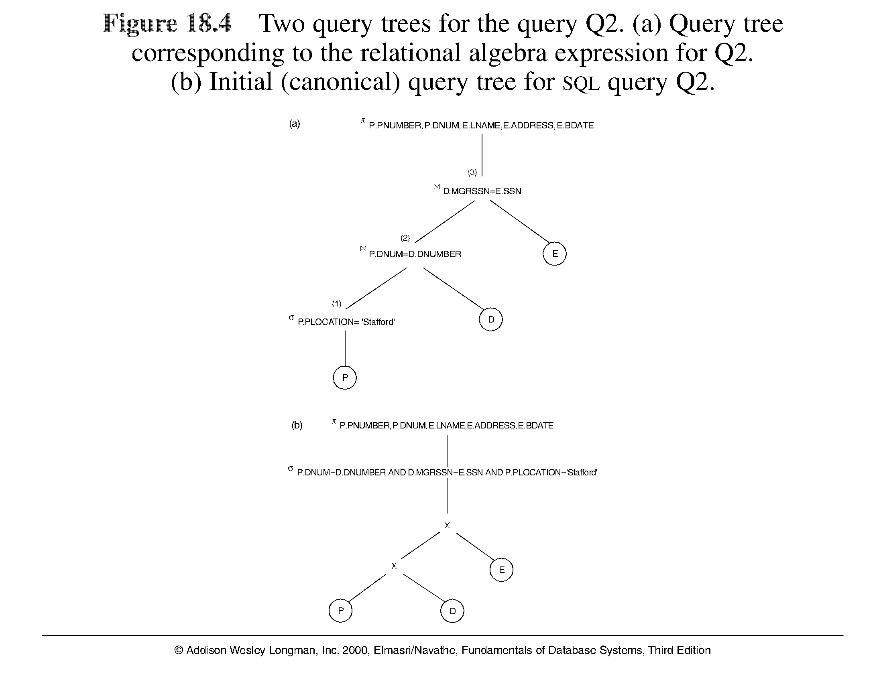
Using Heuristics in Query Optimization (4)

Slide 12
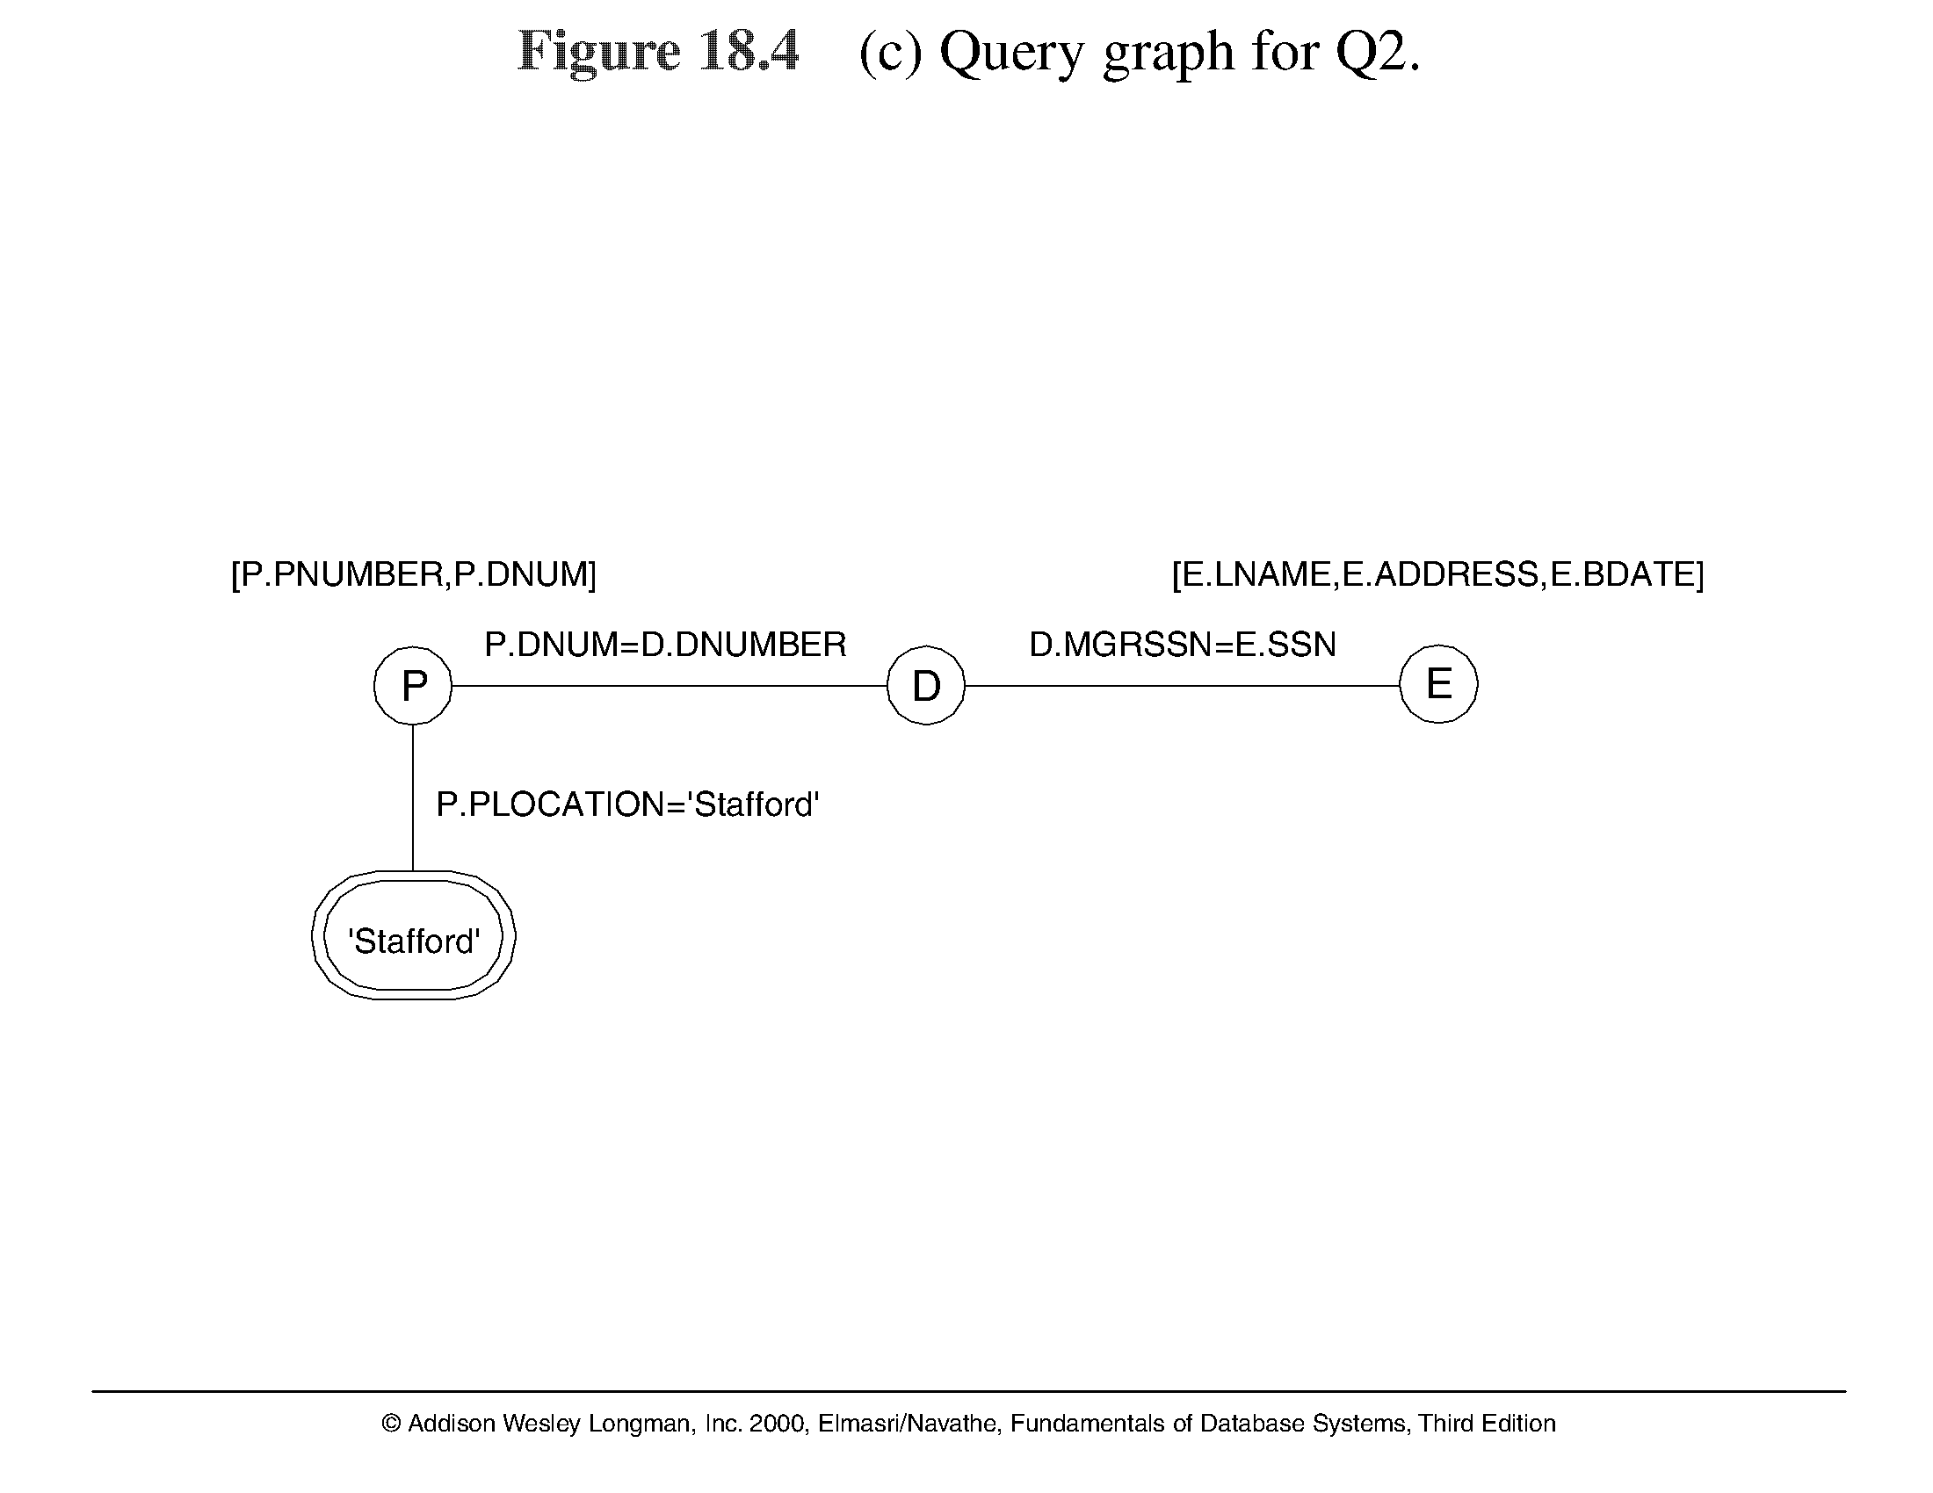
Using Heuristics in Query Optimization (5)

Slide 13
Using Heuristics in Query Optimization (6)
Heuristic Optimization of Query Trees:
The same query could correspond to many different relational algebra expressions — and hence many different query trees.
The task of heuristic optimization of query trees is to find a final query tree that is efficient to execute.
Example:
Q: SELECT LNAME
FROM EMPLOYEE, WORKS_ON, PROJECT
WHERE PNAME = ‘AQUARIUS’ AND PNMUBER=PNO
AND ESSN=SSN AND BDATE > ‘1957-12-31’;

Slide 14
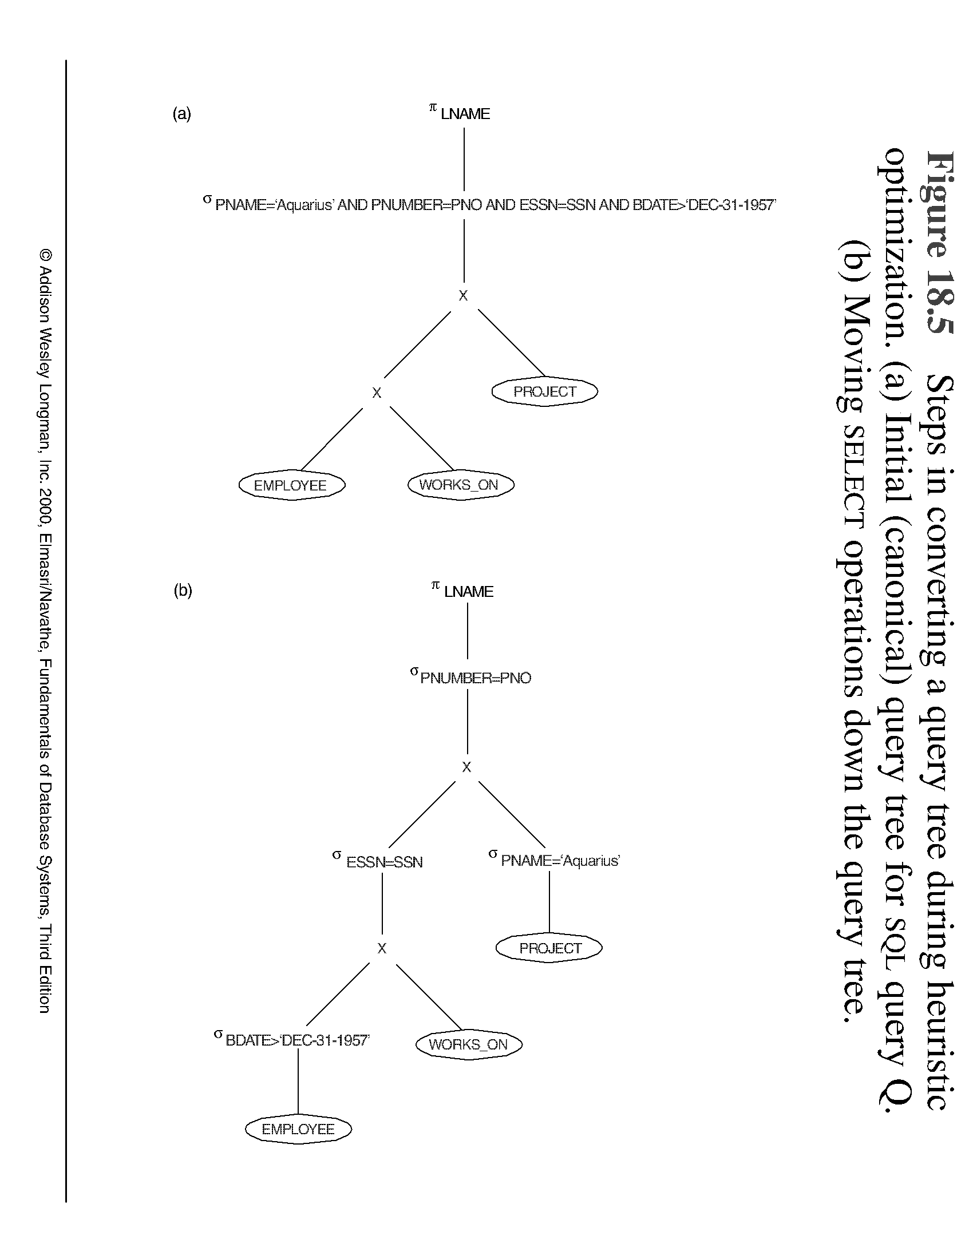
Using Heuristics in Query Optimization (7)

Slide 15
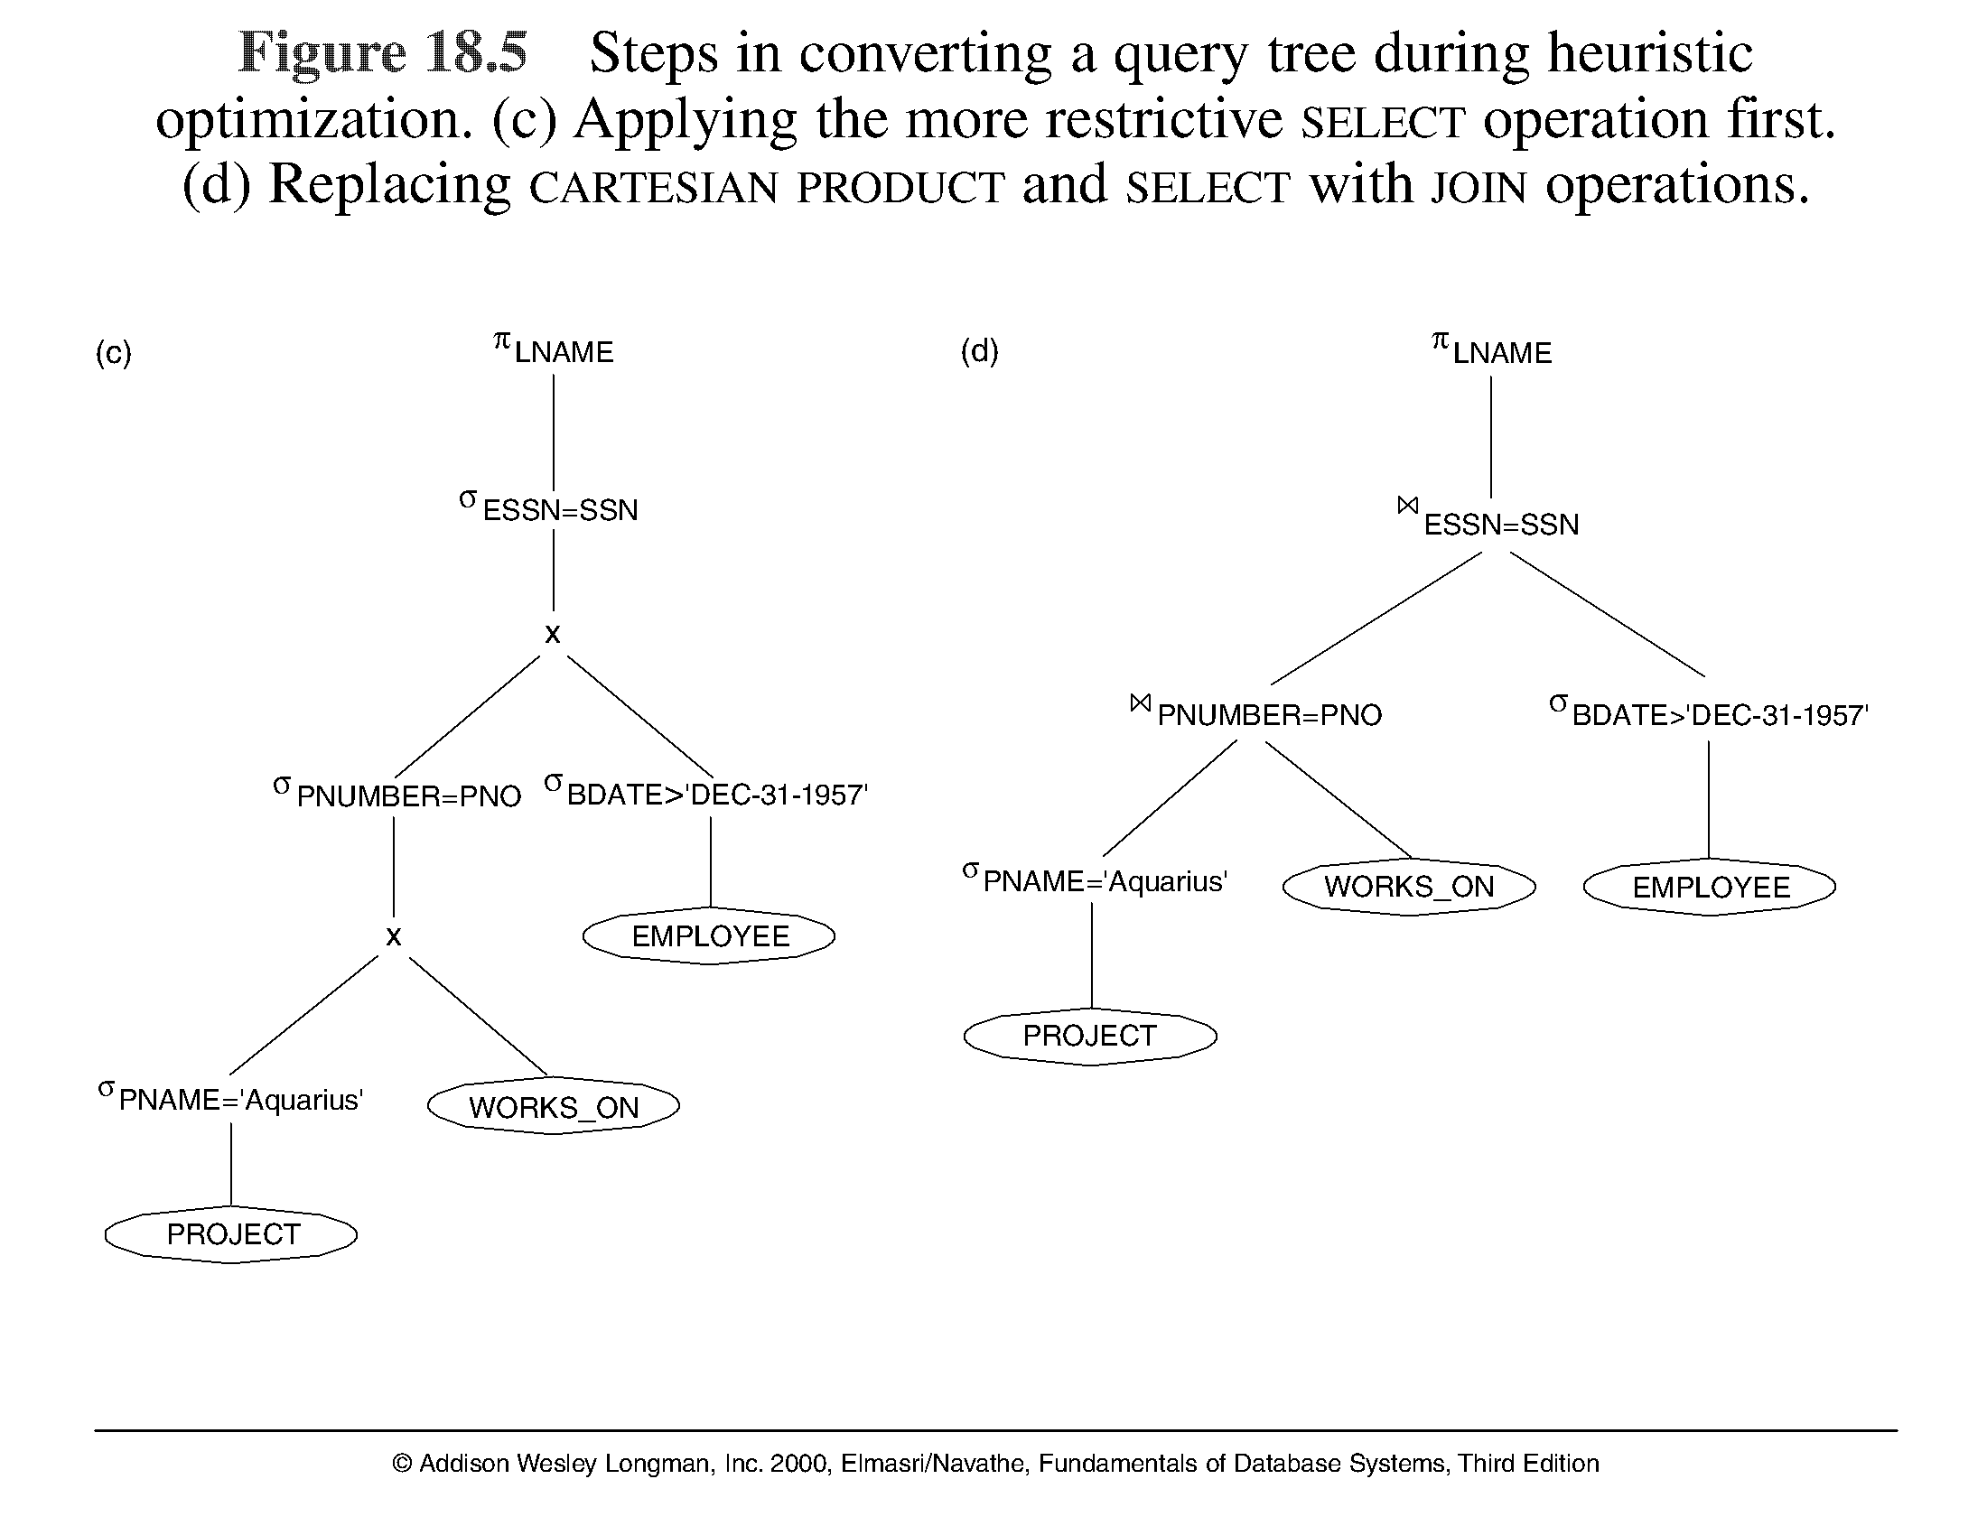
Using Heuristics in Query Optimization (8)

Slide 16
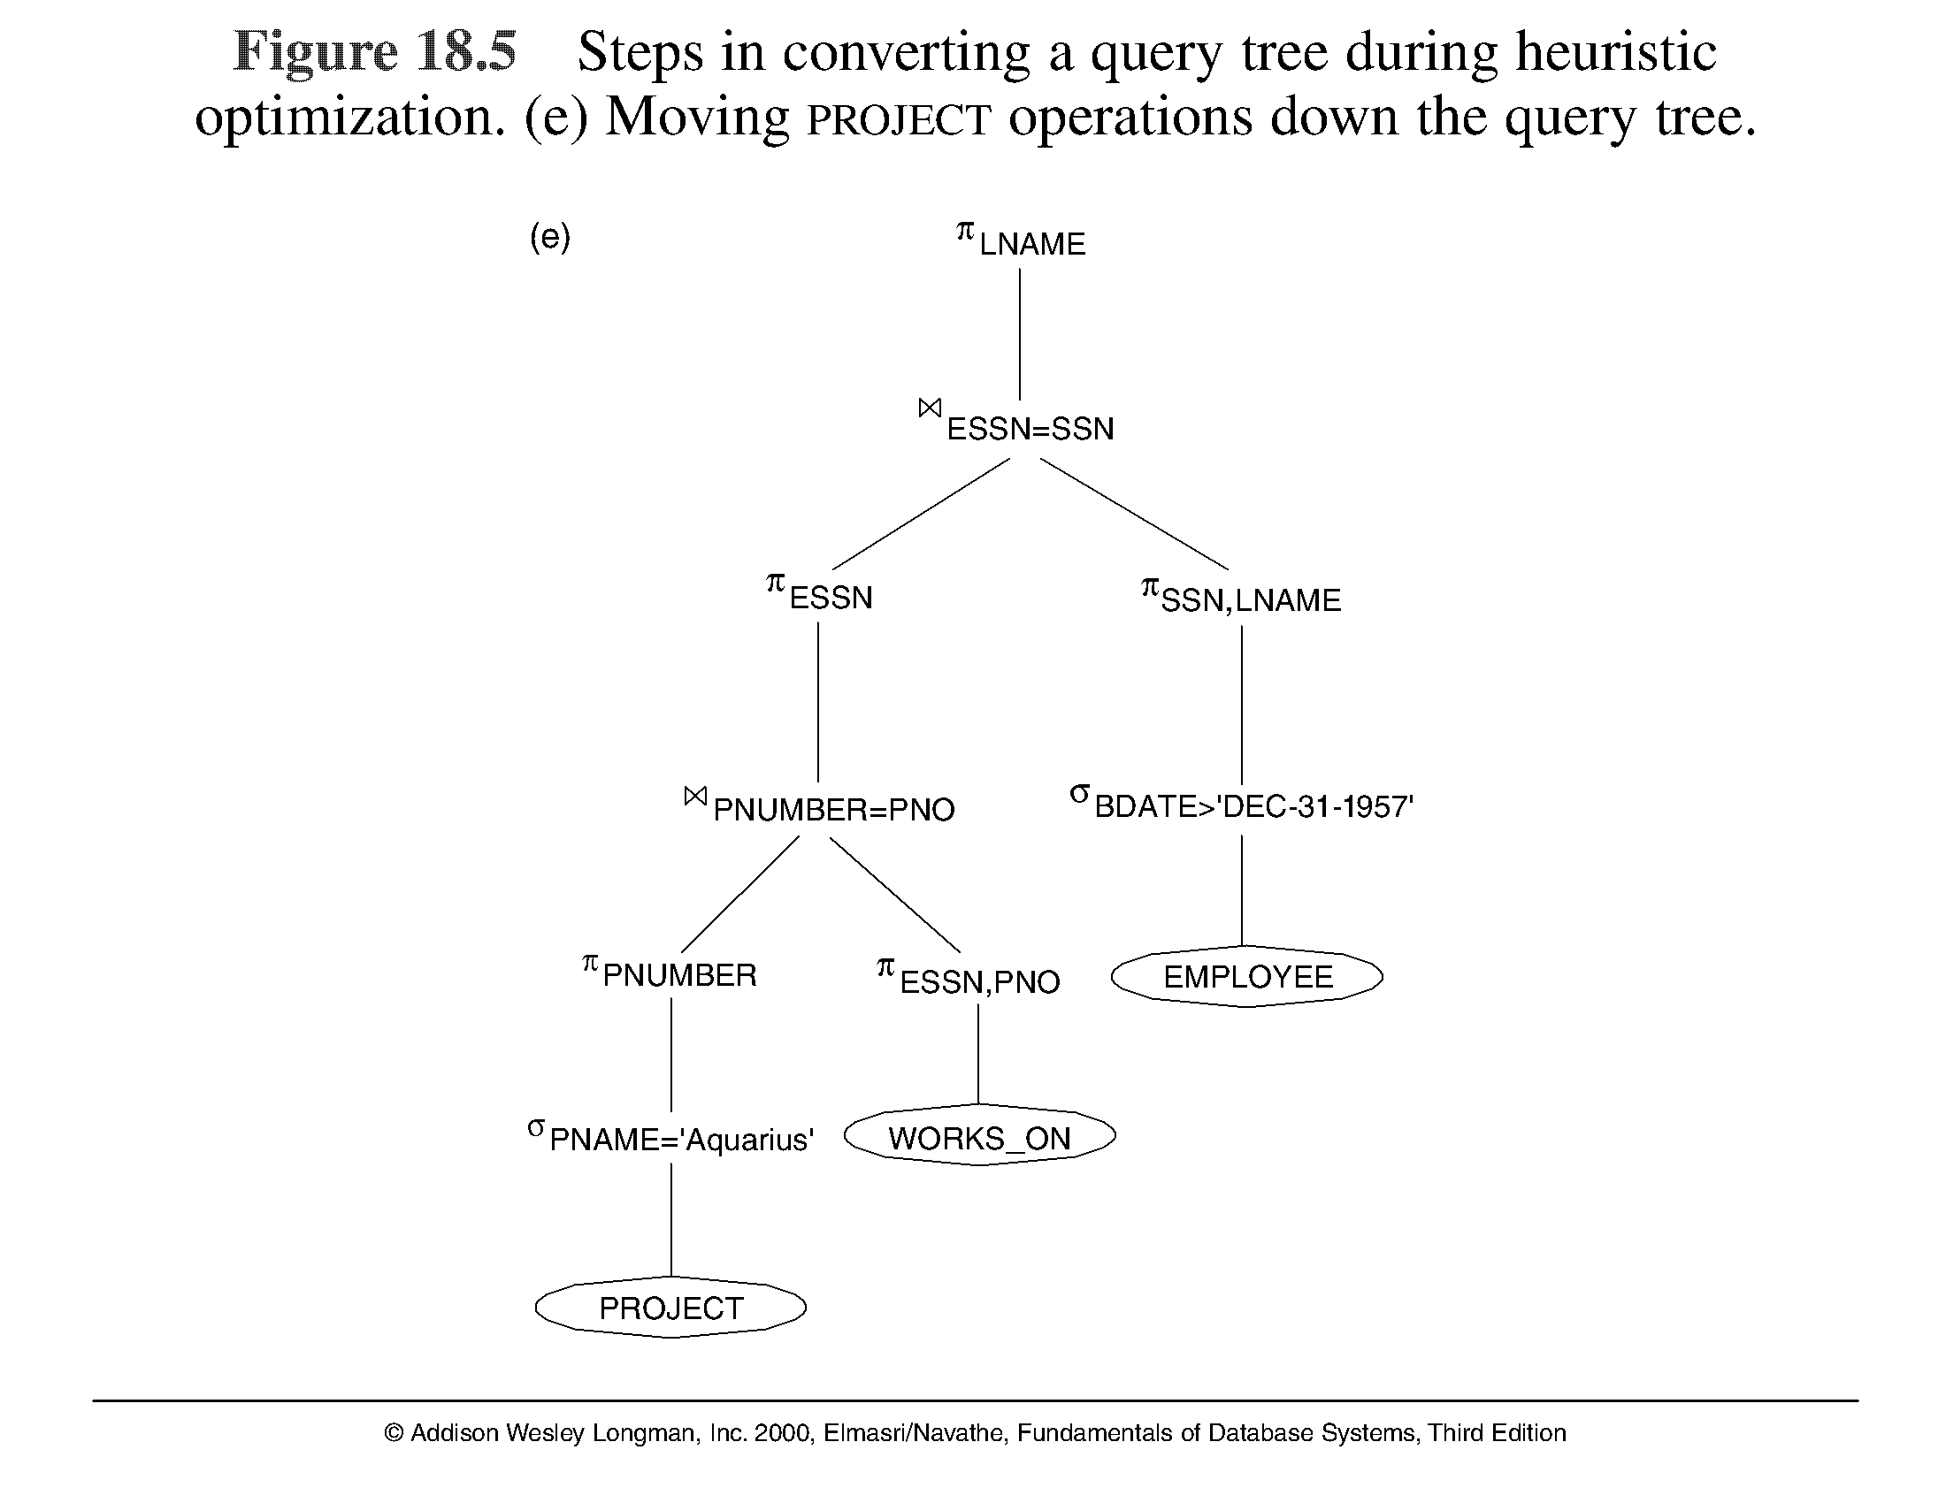
Using Heuristics in Query Optimization (9)

Slide 17
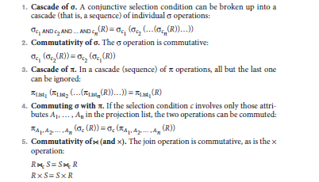
General Transformation Rules for Relational Algebra Operations

Slide 18
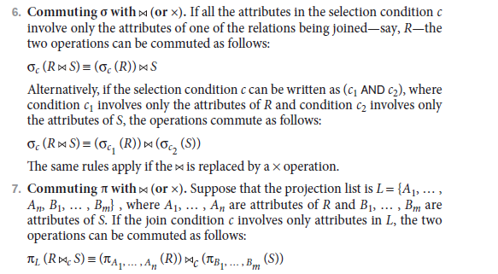

Slide 19
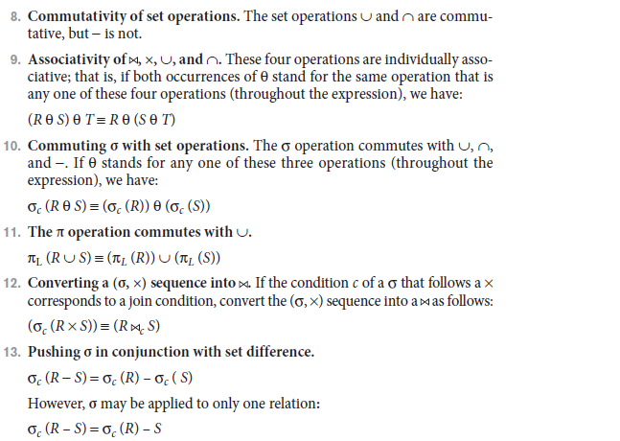

Slide 20
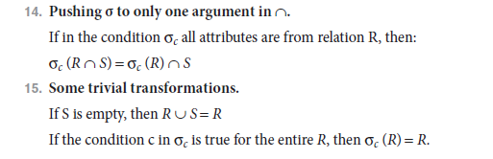

Slide 21
Using Heuristics in Query Optimization (15)
Outline of a Heuristic Algebraic Optimization Algorithm:
Using rule 1, break up any select operations with conjunctive conditions into a cascade of select operations.
Using rules 2, 4, 6, and 10 concerning the commutativity of select with other operations, move each select operation as far down the query tree as is permitted by the attributes involved in the select condition.
Using rule 9 concerning associativity of binary operations, rearrange the leaf nodes of the tree so that the leaf node relations with the most restrictive select operations are executed first in the query tree representation.
Using Rule 12, combine a cartesian product operation with a subsequent select operation in the tree into a join operation.

